Slide 1


SAP UI5 & FIORI with OData TRAINING
Anubhav Oberoy & Nishan Nainsukha
Day – 15

Slide 2

Agenda – Day 15
EPM Data Model
Runtime Artefacts
Tcode
Creating OData Service
Building GetEntitySet Method
Building GetEntity(Single Record) Method
Building CreateEntity (Post) Method
Testing the Create Method at Sap Gateway client

Slide 3
EPM Data Model
Enterprise Procurement Model – Products, Business Partner (Suppliers and Customers), Orders and Order Items.
BAPIs = Function Modules which are reusable and can be called from another systems as well
BAPI_EPM*
BAPI_EPM_PRODUCT_GET_LIST – All the list of products in the system
BAPI_EPM_PRODUCT_GET_DETAIL – details of a single product
BAPI_EPM_PRODUCT_CREATE – create a new product
BAPI_EPM_PRODUCT_UPDATE – update existing product
BAPI_EPM_PRODUCT_DELETE – delete the product
Business partners (BP)
BAPI_EPM_BP_GET_LIST
BAPI_EPM_BP_GET_DETAIL
BAPI_EPM_BP_CREATE
BAPI_EPM_BP_UPDATE
BAPI_EPM_BP_DELETE
CRUD
Create
Read
Update
Delete
Reference: https://help.sap.com/viewer/bd833c8355f34e96a6e83096b38bf192/7.4.26/en-US/d1801ea7454211d189710000e8322d00.html

Slide 4

Runtime Artefacts
MPC
Model provider class
DPC
Data Provider Class
MPC_EXT
Developer writes their custom code
DPC_EXT
Developer writes their custom code CURDQ
Service – PROJECTNAME_SRV
Per method there are 5 methods generated
GET_ENTITYSET, GET_ENTITY, CREATE, UPDATE, DELETE

Slide 5
TCode
SEGW – Service Builder
/N/IWFND/MAINT_SERVICE – Registration of services
/N/IWFND/ERROR_LOG – Error logs of service calls
/N/IWFND/GW_CLIENT – test services locally within sap system
ABAP SEGW CLASSES
It has the code which provides the metadata
SAP Generated
It has the code which provides the actual data in the output when EntitySet is called
Runtime Artifacts
MPC
(Model provider Class)
DPC
(Data Provider Class)
MPC_EXT (Extension)
Code which developer will write
DPC_EXT (Extension)
All the ABAP Code which works with CRUD implementations

Slide 6
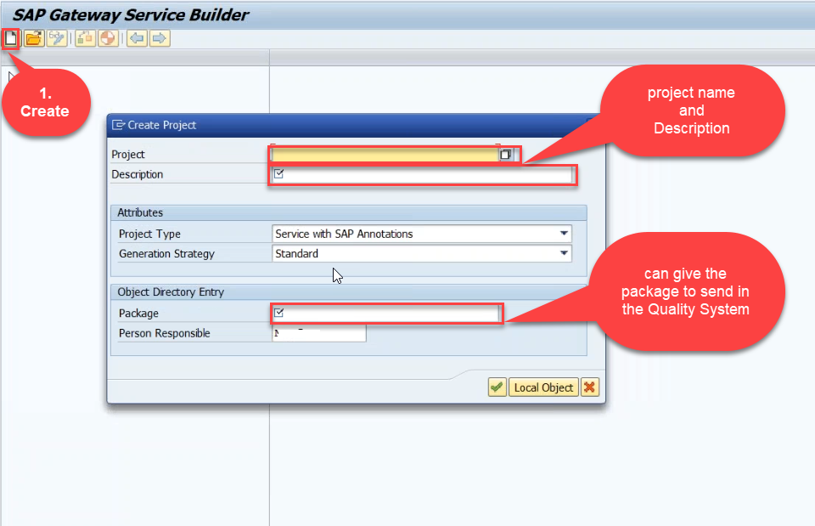
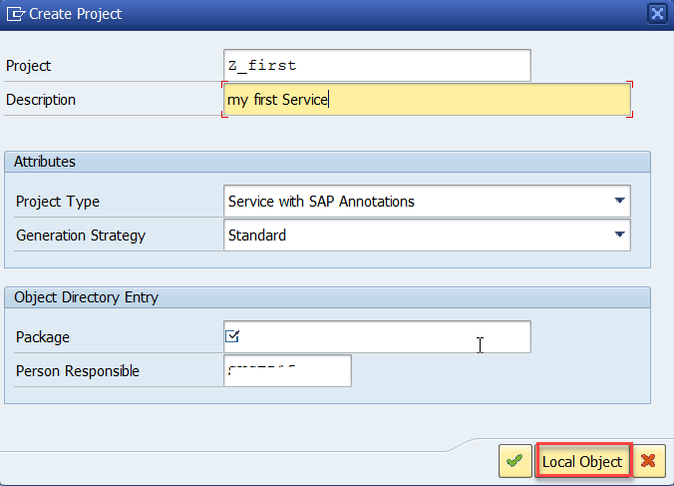
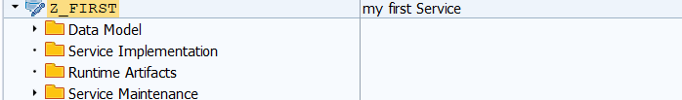
Creating OData Service
Step1: Strat your SAP LOGON, and to Sap Gateway Service Builder(SEGW) and click on Create

Slide 7
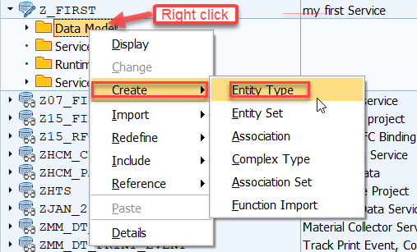
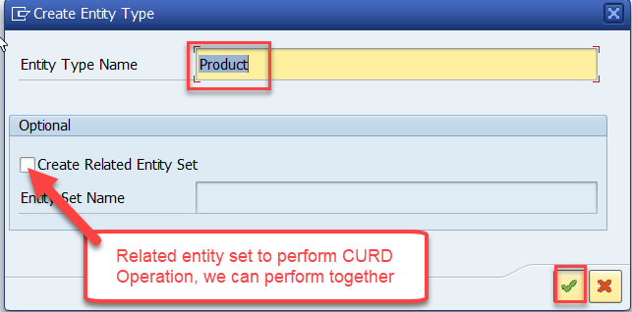
Creating OData Service
Step2: Defining the Data Model (Blue print of data)

Slide 8
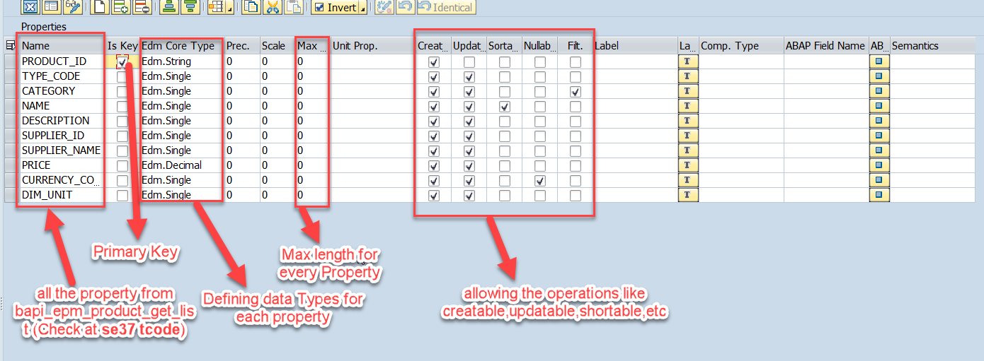
Creating OData Service
Step3: Creating Properties for data model (from bapi_epm_product_get_list (tcode- se37))

Slide 9
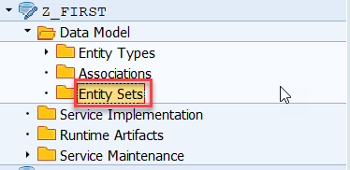
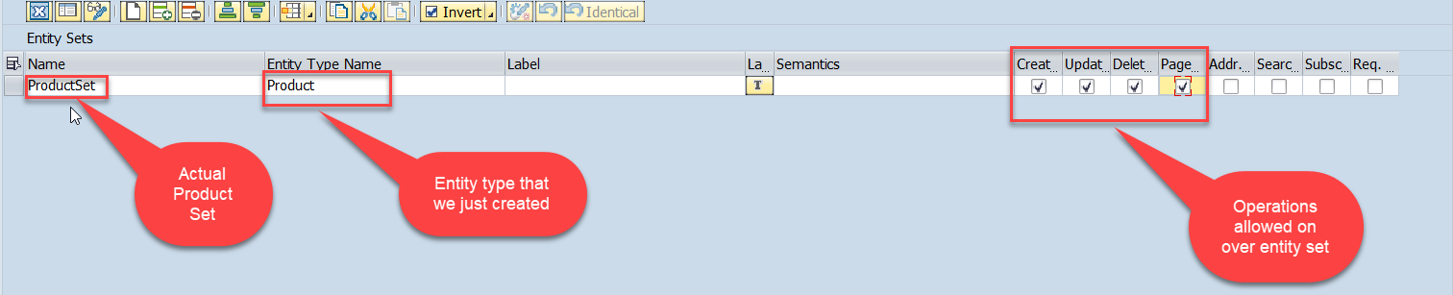
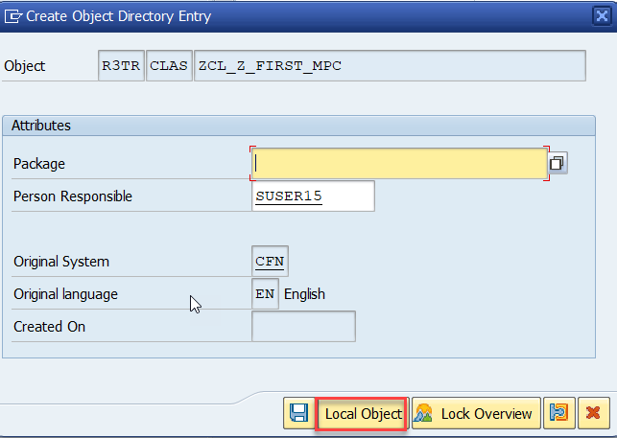
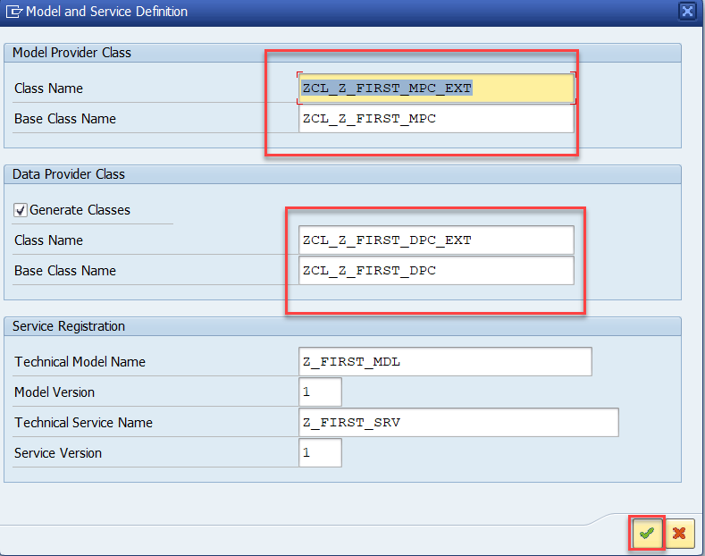
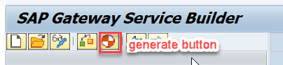
Creating OData Service
Step4: Creating entity set to perform actual CURD operations and service generation

Slide 10
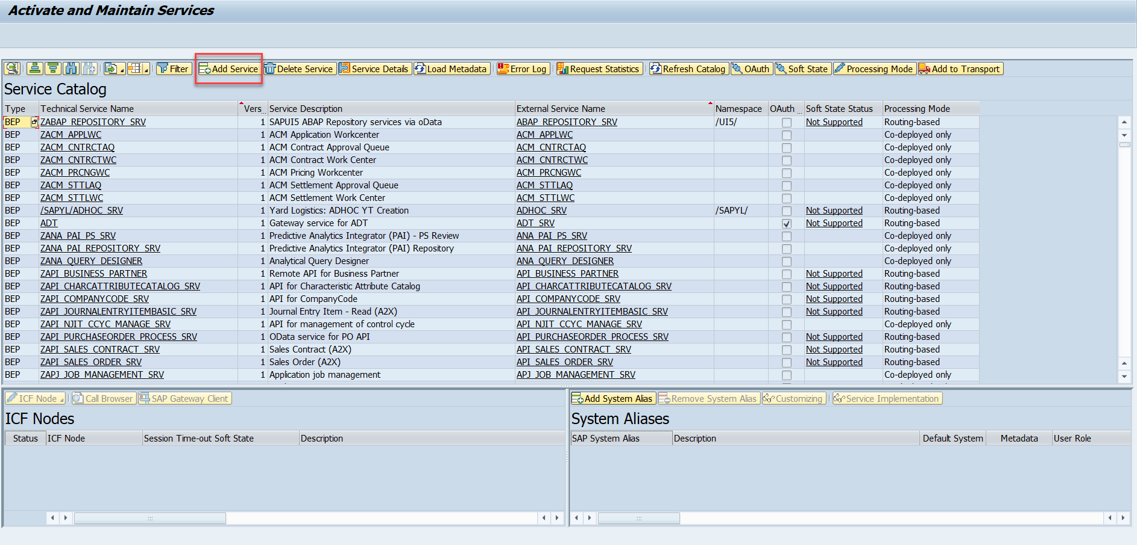
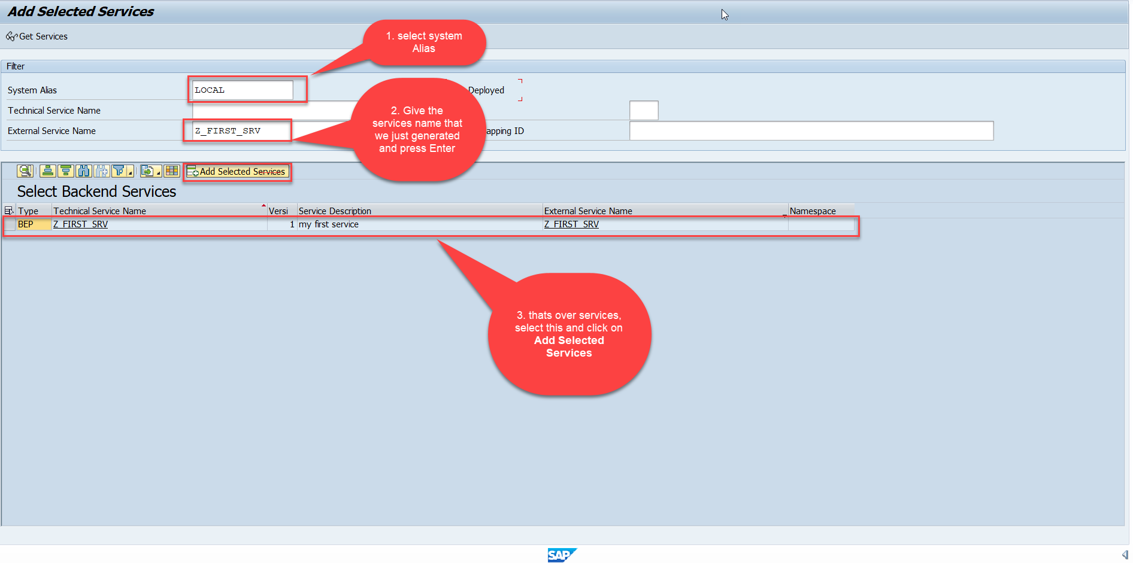
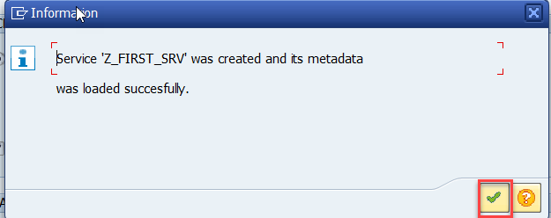
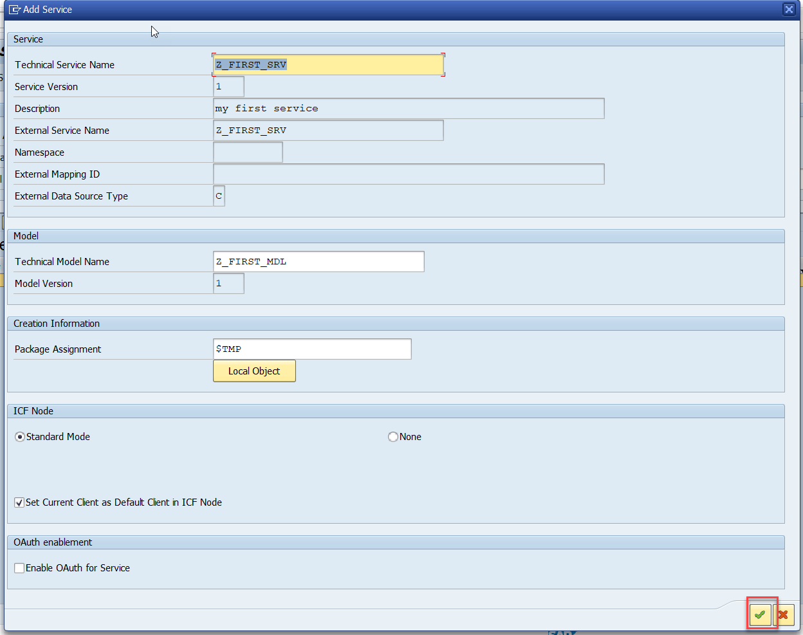
Creating OData Service
Step5: Service Registration (Go to tcode- /iwfnd/maint_service)

Slide 11
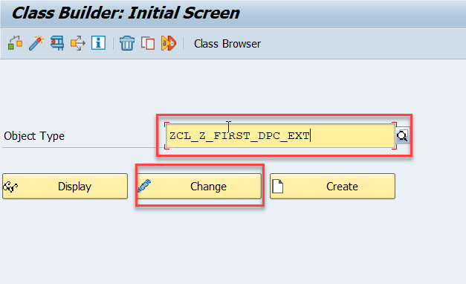
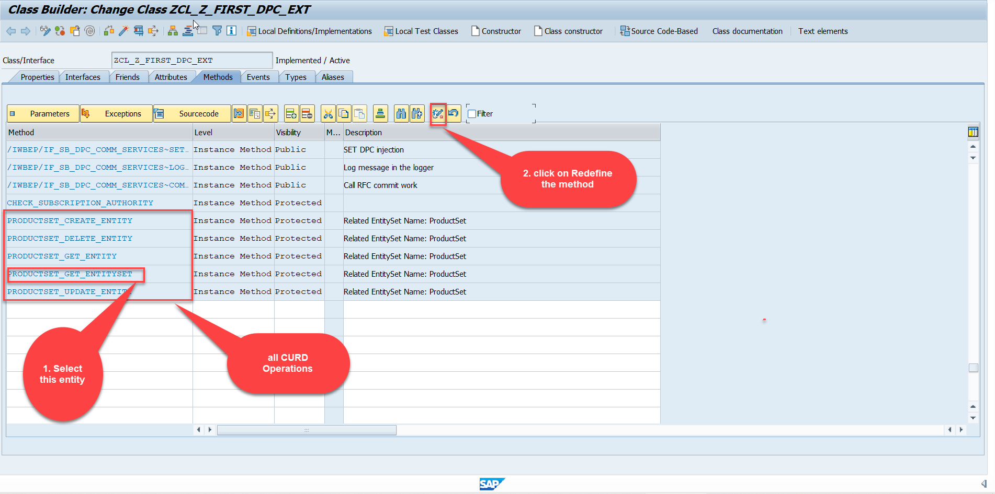
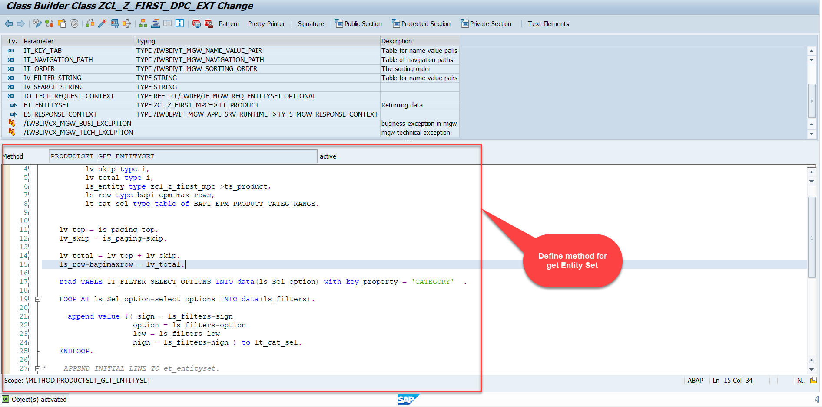
Building GetEntitySet Method
Step1: ProductSet Get Entity method(with filter, top and skip) in DPC Extension (Class Builder tcode- se24)
Note: Click on the image to get Complete code.

Slide 12
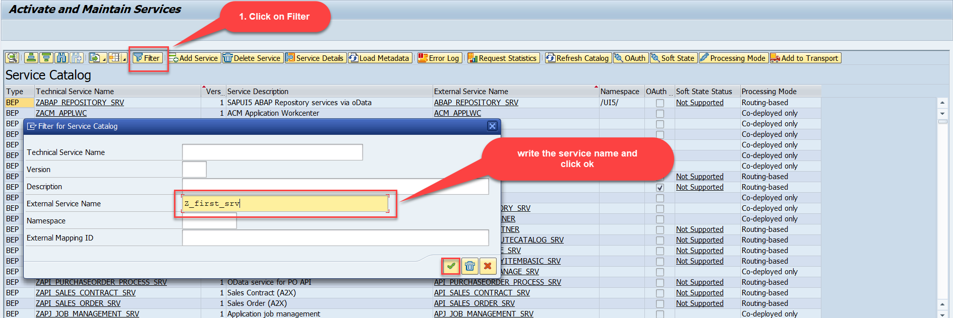
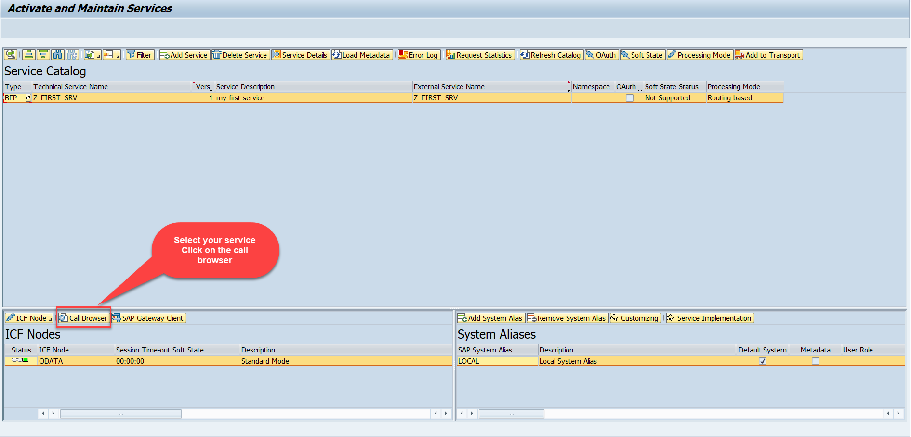
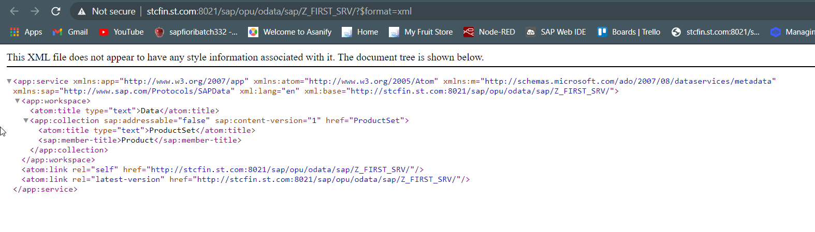
Building GetEntitySet Method
Step2: Call the service to the browser that we just created (go to service maintain (/iwfnd/maint_service))
Service in Browser

Slide 13
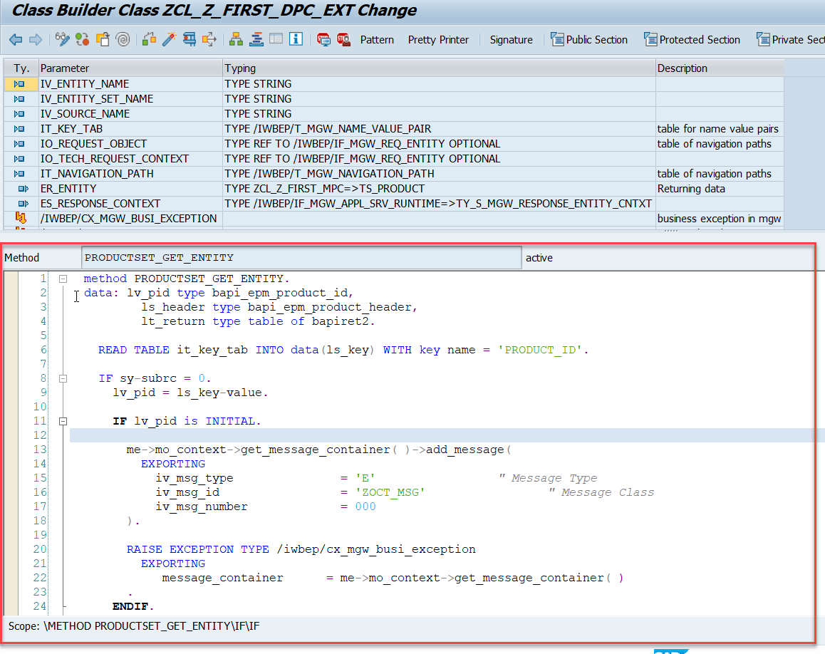
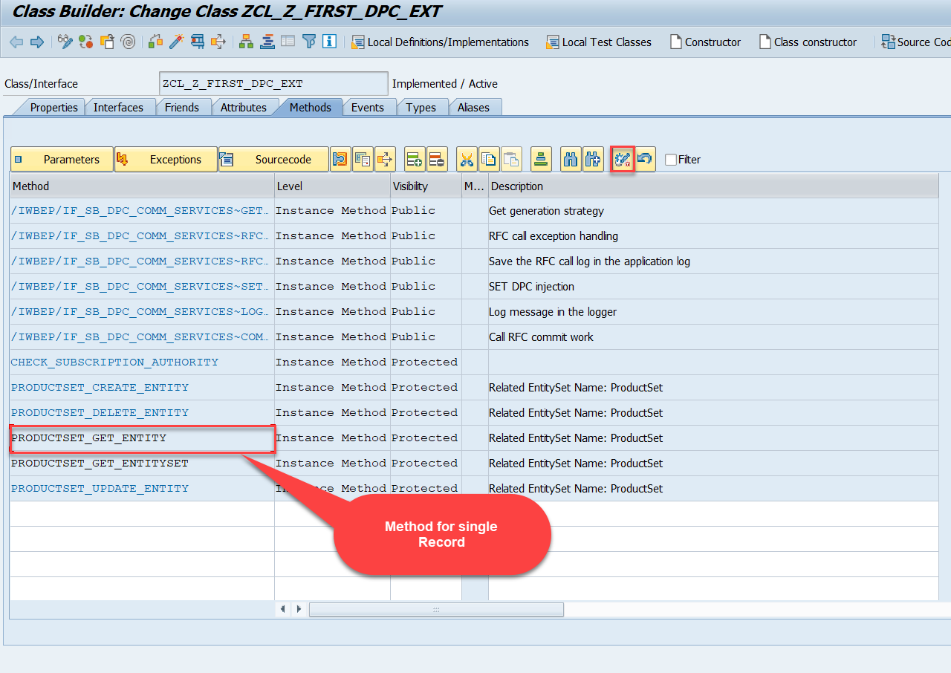
Building GetEntity(Single Record) Method
Go to DPC Extension of over service and redefine the method PRODUCTSET_GET_ENTITY

Slide 14
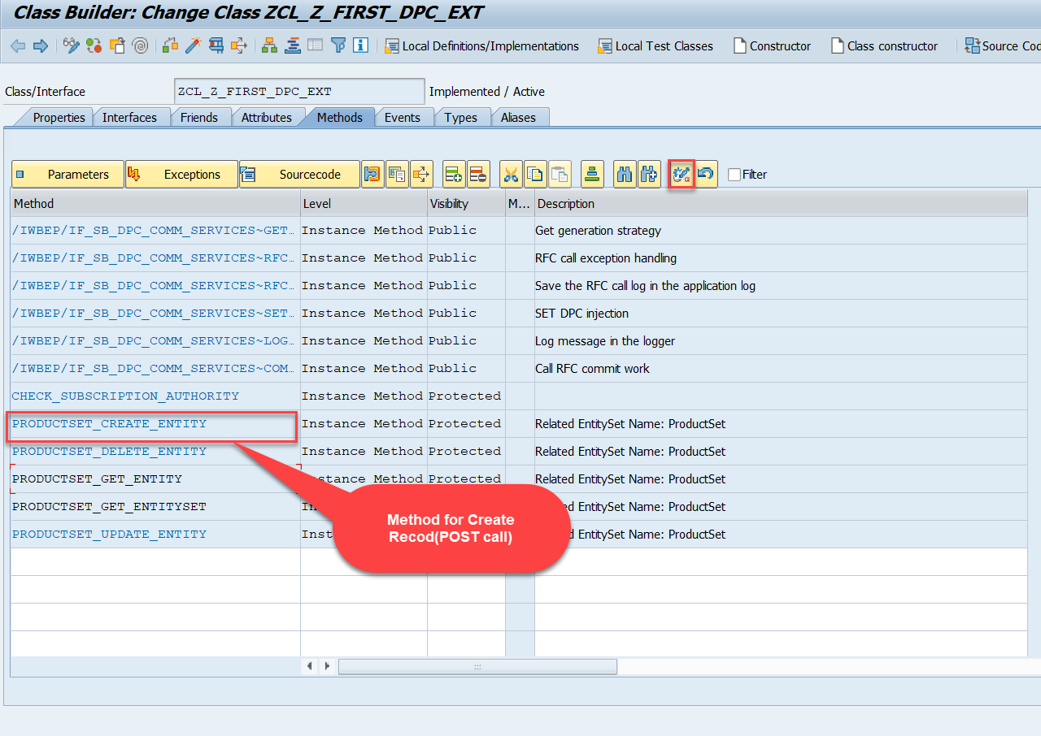
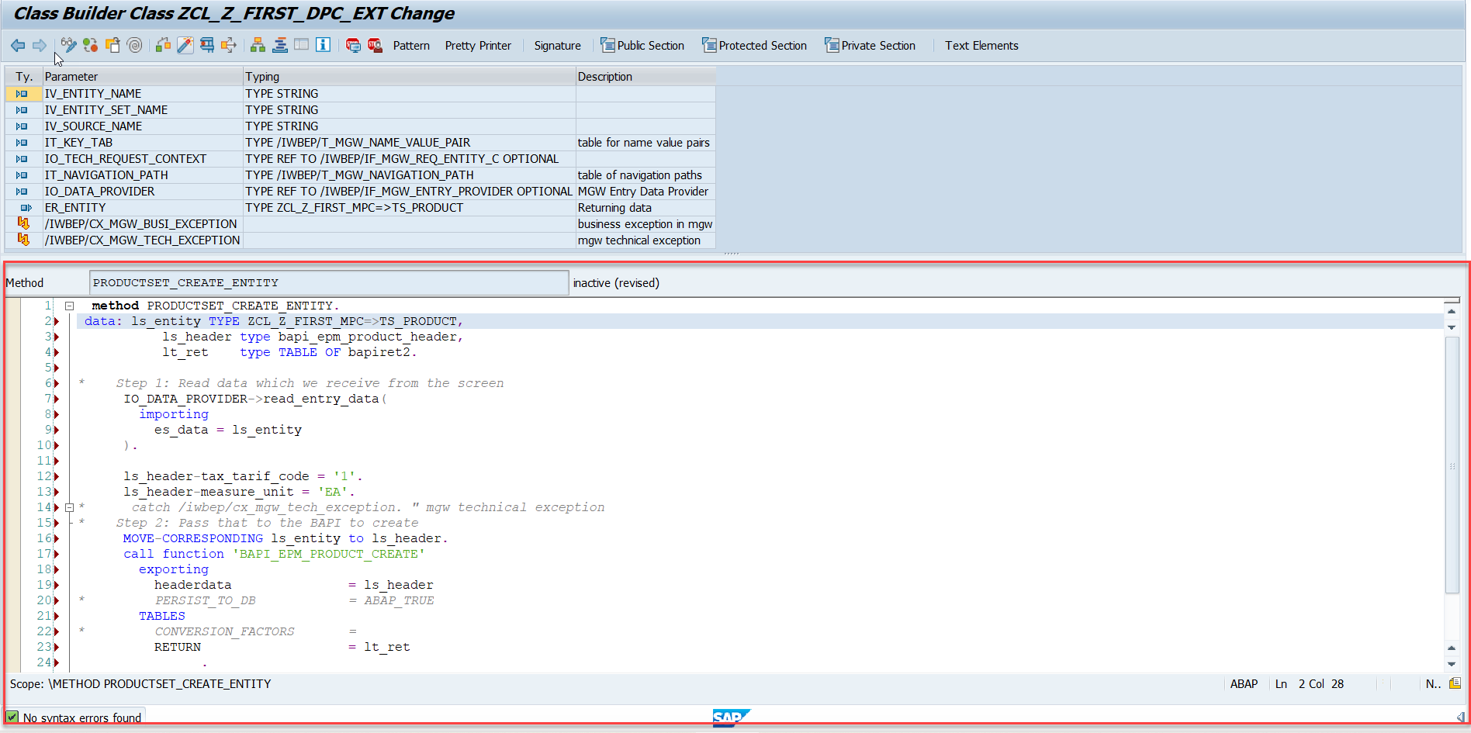
Building CreateEntity(POST) Method
Go to DPC Extension of over service and redefine the method PRODUCTSET_CREATE_ENTITY

Slide 15
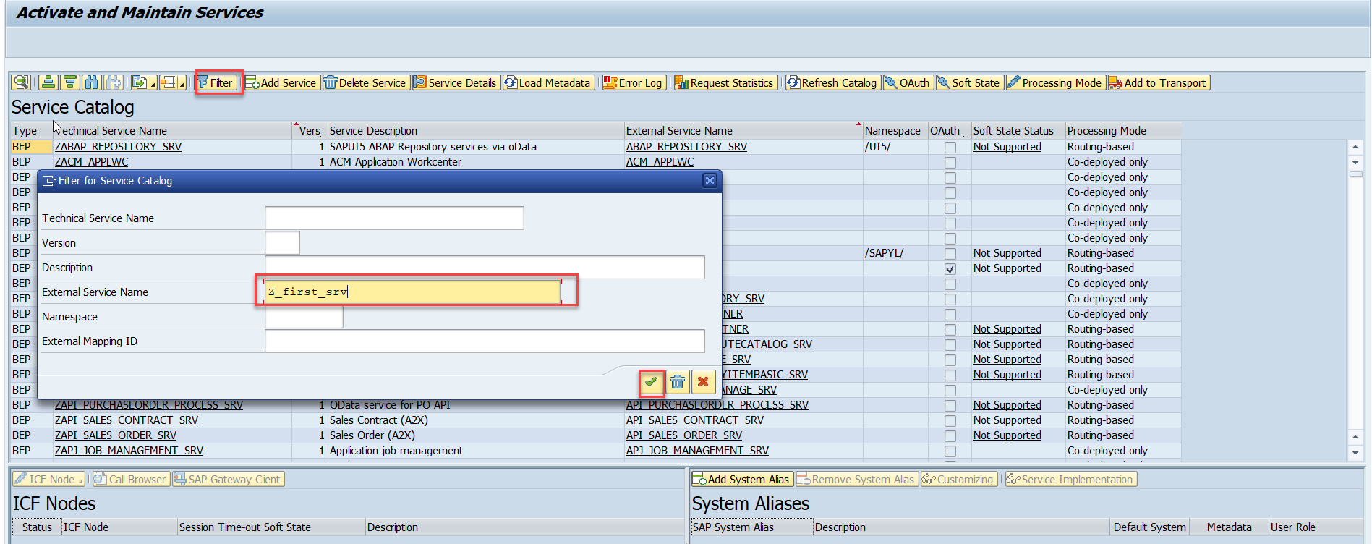
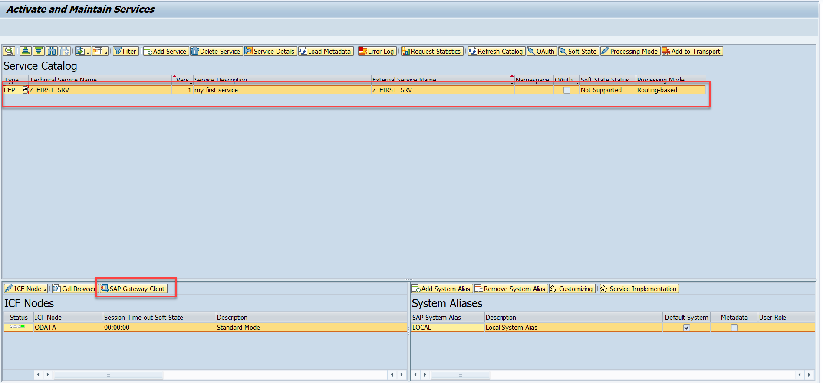
Testing the Create Method at Sap Gateway client
Step:1 Go to sap service maintance(tcode- /iwfnd/maint_service) and search for the service and then select the service and click on the sap gateway client

Slide 16
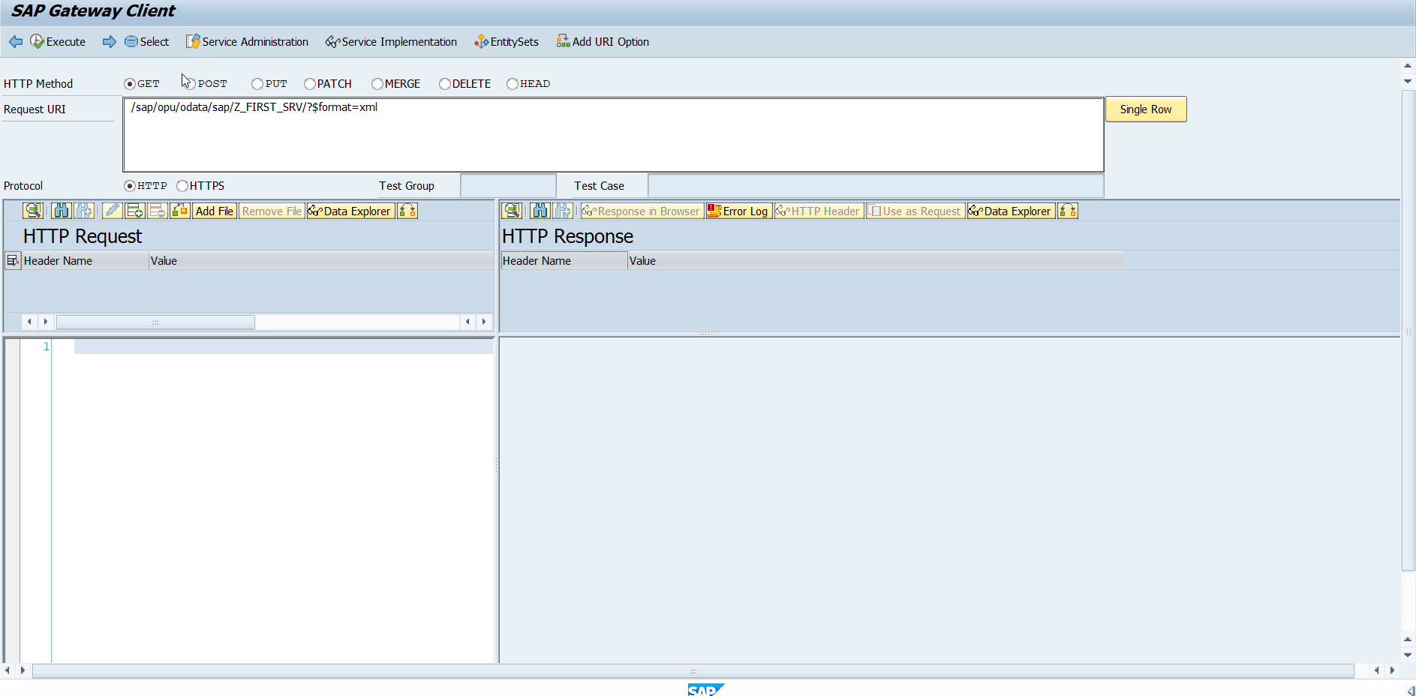
Testing the Create Method at Sap Gateway client
Step:2 Go to sap service maintance(tcode- /iwfnd/maint_service) and search for the service and then select the service and click on the sap gateway client

Slide 17
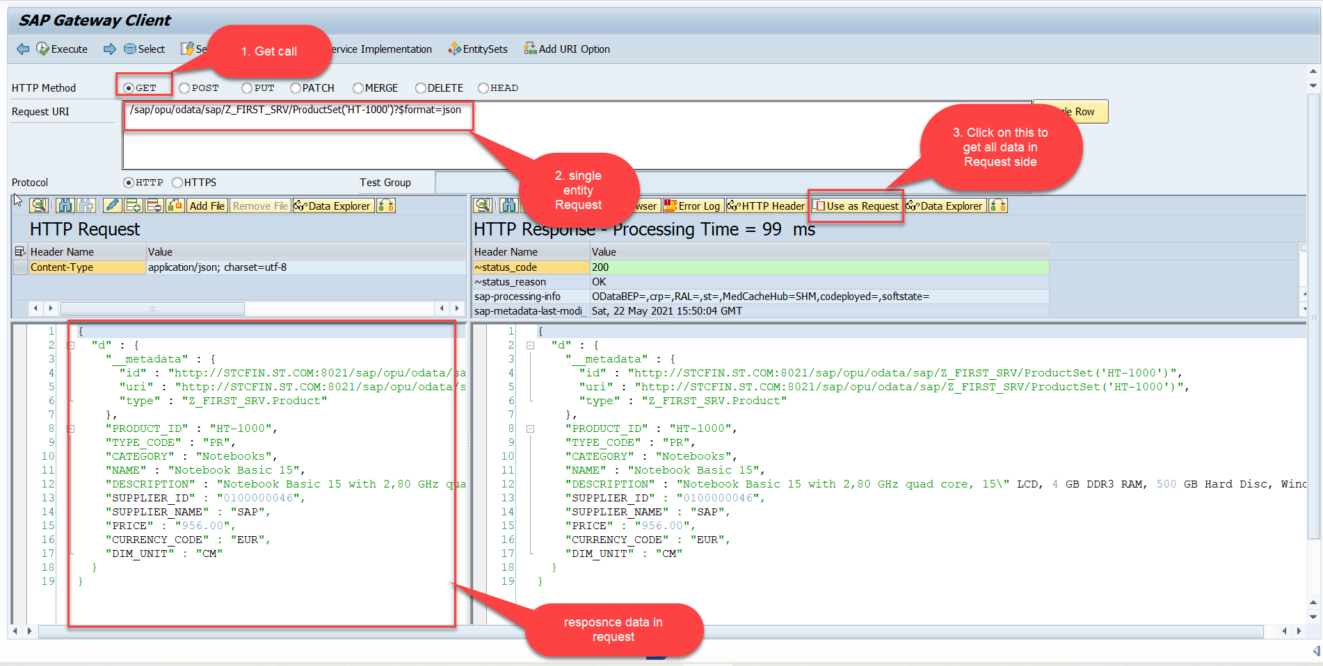
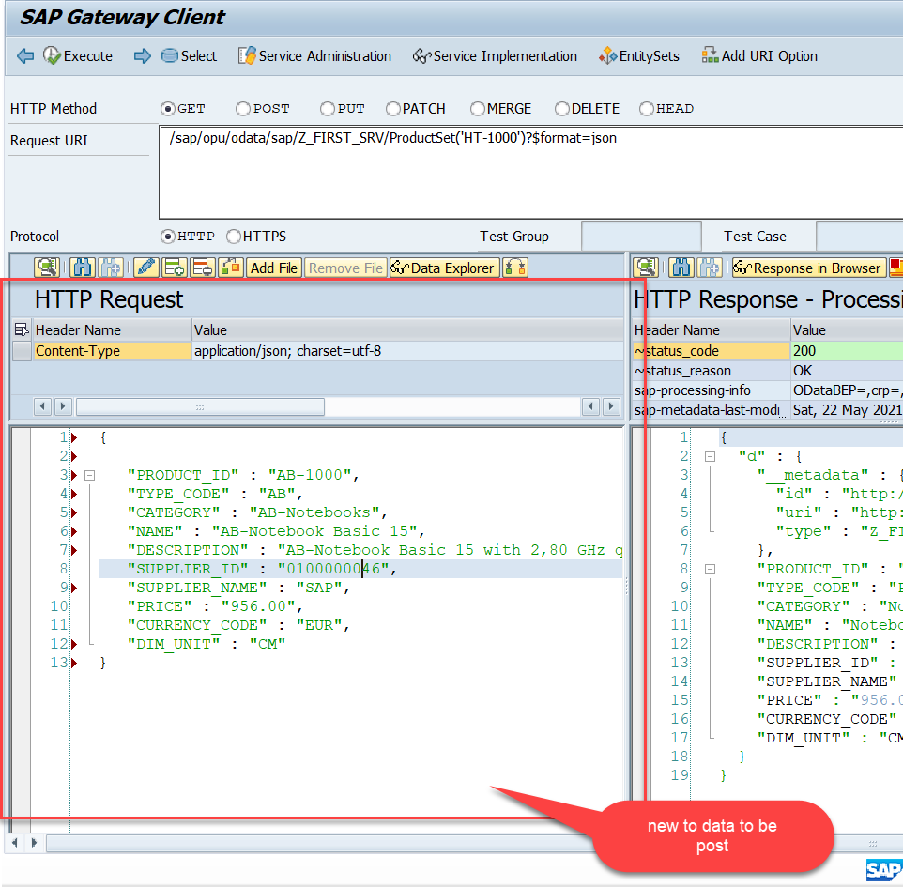
Testing the Create Method at Sap Gateway client
Step:3 Perform a getEntity in the Product set to get the payload to post (/sap/opu/odata/sap/Z_FIRST_SRV/ProductSet('HT-1000')?$format=json) and then clean the data and modify the payload as new.

Slide 18
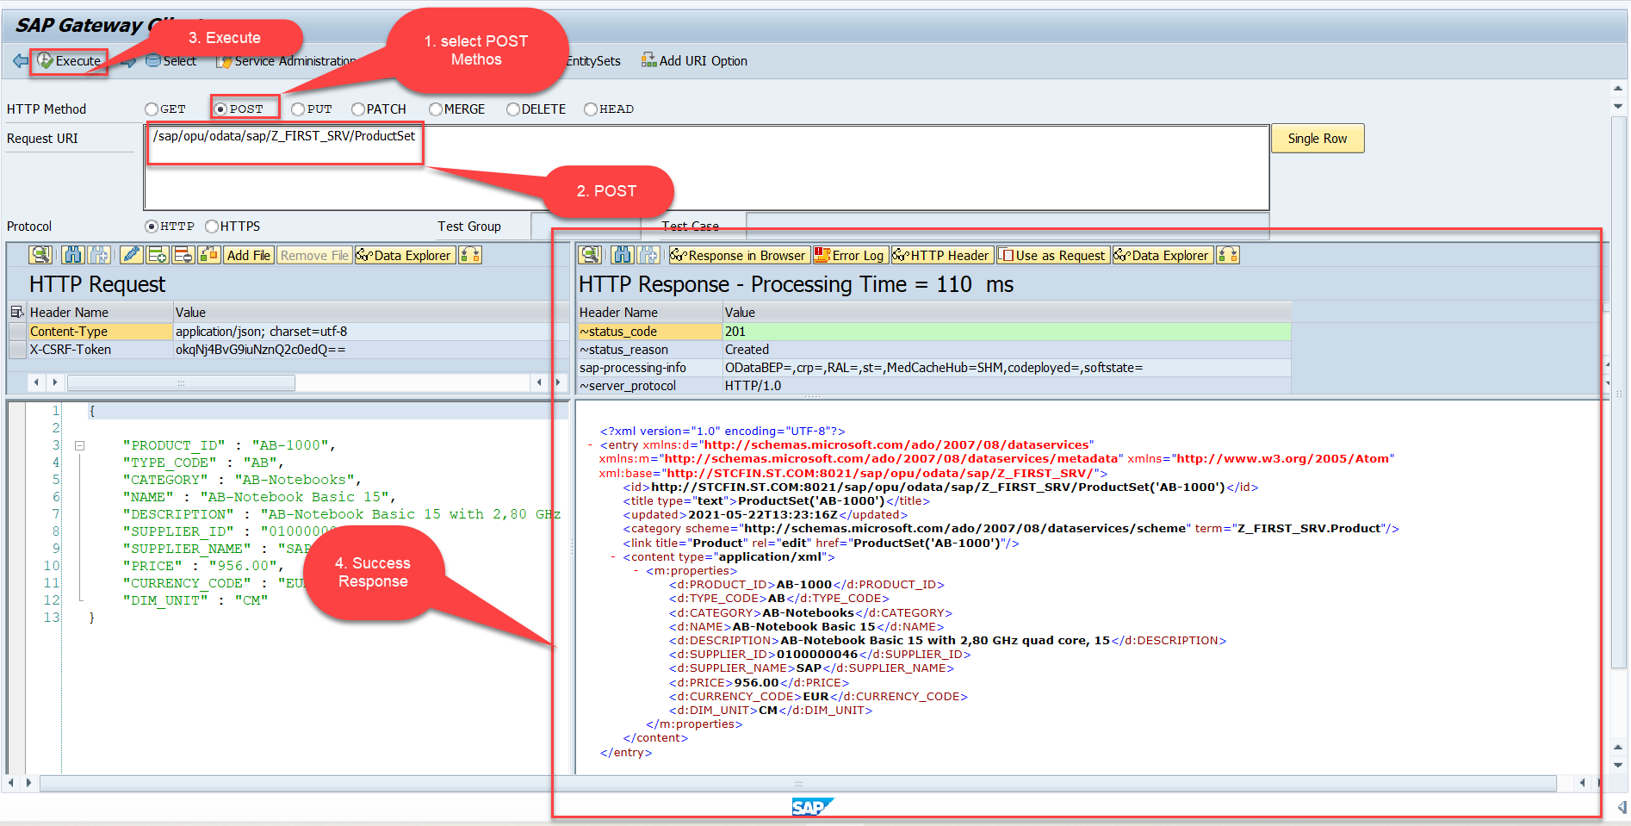
Testing the Create Method at Sap Gateway client
Step:4 send the post request at (/sap/opu/odata/sap/Z_FIRST_SRV/ProductSet)
You can check the saved data in database table (tcode – se11)

Slide 19

End of Day 15

Slide 20

Questions

Slide 21

Anubhav Oberoy

Slide 22


We’re committed to empower you to be
Most Desirable Resource
through powerful training solutions.
We build the workforce of the future.
250+
Corporate Clients
30,000+
Learners Trained
25000+
Learners Placed
FREE WEBINARS
Sign up for free webinars with industry experts every fortnight!
Enroll Now!
Contact us today!
https://anubhavtrainings.com/

Slide 23




More from AnubhavTrainings.com

